Slide 1

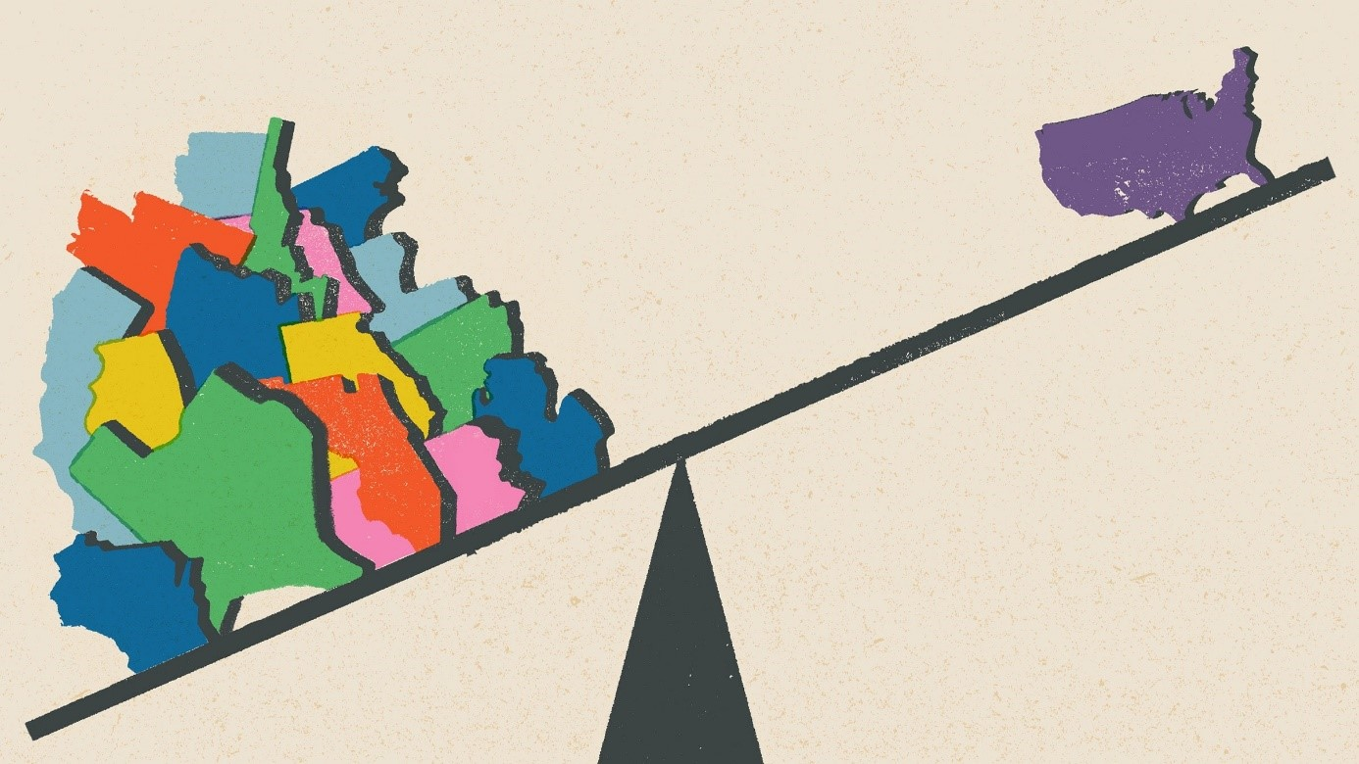





The White House Embattled:
The U.S. Election 2024
Lecture Series of the North American Studies Program |
in cooperation with the Amerika Haus NRW e. V., the Bundeszentrale für politische Bildung (bpb), and the Deutsch-Kanadische Gesellschaft e. V. (DKG)
The U.S. Constitution and political system separate powers between branches and levels of government. Despite such division and decentral-ization of powers, national political-party competition, also over the pres-idency, has intensified within the states themselves. Yet, these trends have not produced more centraliza-tion, but make individual states more nationally relevant than ever, not least given their predominant authority over elections, including federal ones. Against this backdrop, Dr. Sonnick-sen’s lecture focuses on the 2024 elec-tion in the larger context of how U.S. institutions of federalism and demo-cracy interact, and interrogates the role of the states in the electoral process.
Prof. Dr. Jared Sonnicksen covers the area of political systems at the Institute of Political Science, RWTH Aachen University. His academic work focuses on comparative government in Europe and North America, as well as comparative federalism and multi-level governance. His particular inter-est is in challenges of democracy under complex political conditions.
The Presidential Elections: Views from the States of the U.S. Federal Democracy
Tuesday | 14 May 2024 | 6:00-8:00 pm
53111 Bonn | Rabinstraße 8 | Seminarraum 8
Prof. Dr. Jared Sonnicksen
RTWH Aachen

