Slide 1

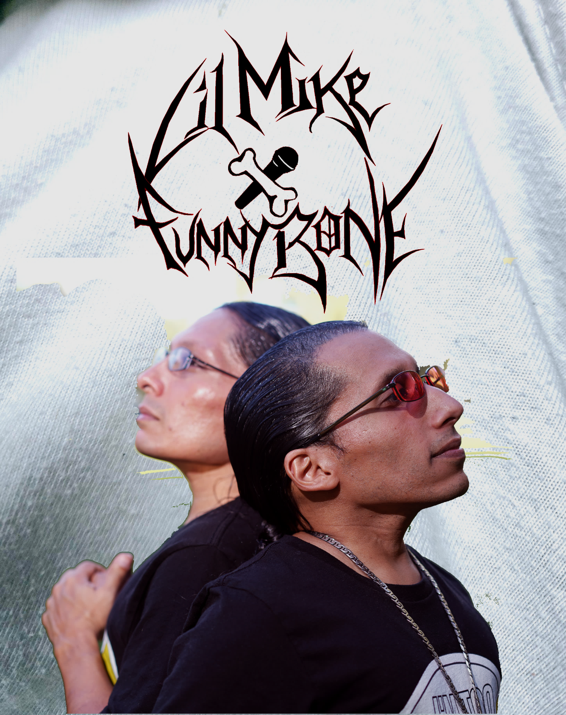

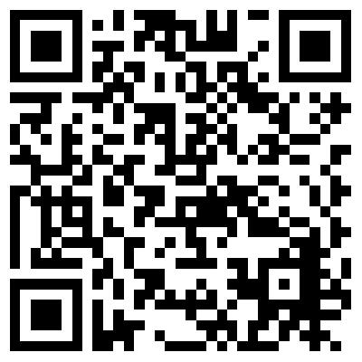



CURRENT ISSUES
IN NORTH AMERICAN AND CULTURAL STUDIES
Monday
October 13, 2025
6:15 – 7:45 pm
(CET)
on Zoom
Putting a Positive Spin on the Game:
Reflections on Hip Hop, Art, and Life
Lil Mike and Funny Bone
For this year’s Indigenous Peoples’ Day Lecture, we have the pleasure of hosting Pawnee artists Lil Mike and Funny Bone who will speak to us about how their art has allowed them to “put a positive spin on the rap game” and to claim and reclaim Native presences within North American popular culture. They will spotlight different stages of their careers and will share with us how their hip hop practice has prepared them for their acting careers. They will also relate to us the challenges of becoming and being successful Native artists and performers as well as what role religion has played for their lives and practices.
Lil Mike and Funny Bone (Pawnee), also known as Mike Bone, began their careers as artists at an early age, writing poetry and performing their rap songs in front of different audiences. They first received national attention as contestants on America’s Got Talent in 2013, impressing the judges with the song “Rain Dance.” As characters Mose and Mekko on the TV show Reservation Dogs (2021-2023), they convinced audiences across the globe of their multiple talents and consolidated their international fame. Their records include the albums Crunk Nativez (2010), Beat of the Drum (2018), and their most recent release Vibin (2024).
The event will take place on Zoom. Please scan the QR-Code to sign up and receive the Zoom details.

